Slide 1
Social Plugz
Nhlamulo Mangena
ST10125976
IMAD5112A1
Assignment 1

Slide 2
Table Of Contents
Introduction
Purpose of the App
Features
Functions

Slide 3
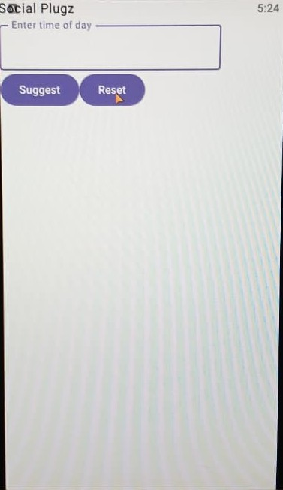
Introduction
Social Plugz is a fully functional Android app that uses an if statement to provide small “social sparks” based on the time of the day.

Slide 4
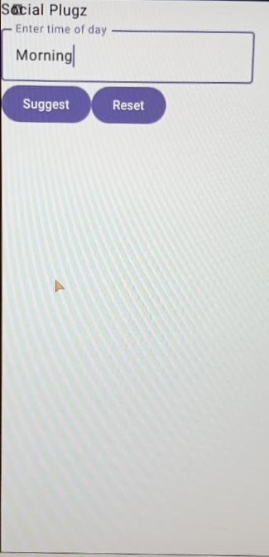
Purpose of the App
The Purpose of this App is to give users suggestions or actions/ tasks they can accomplish upon entering the specific time of the day.
This app can help stay connected while providing users with a specific task they can complete in the specific time of the day.

Slide 5
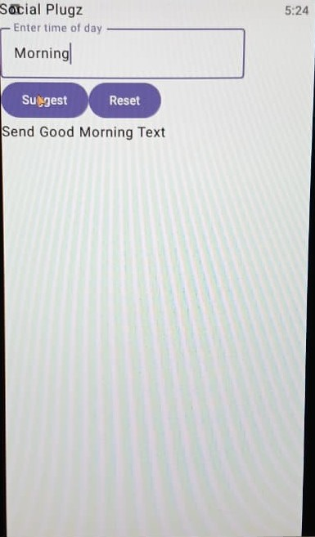
Features
This App consists of a customized text field with a “Enter time of the day” prompt to users.
It also has 2 buttons namely Suggest and Clear
The app lastly consists of an output field where users can read/see the suggestion

Slide 6
Functions
This App’s main function is to output suggestions based on the user’s time of the day input.
Suggest button is used to send the user input into the code in order to display the corresponding task for the specific time of the day.
Eg, User input “Morning” the App will display “Send a Good morning text”.
Clear button is used to erase/clear the current display of information, both input and output field.

Slide 7
Conclusion
In conclusion, Social Plugz is a user friendly app that help’s suggests tasks or actions user’s can do in the particular time of day

